Slide 1
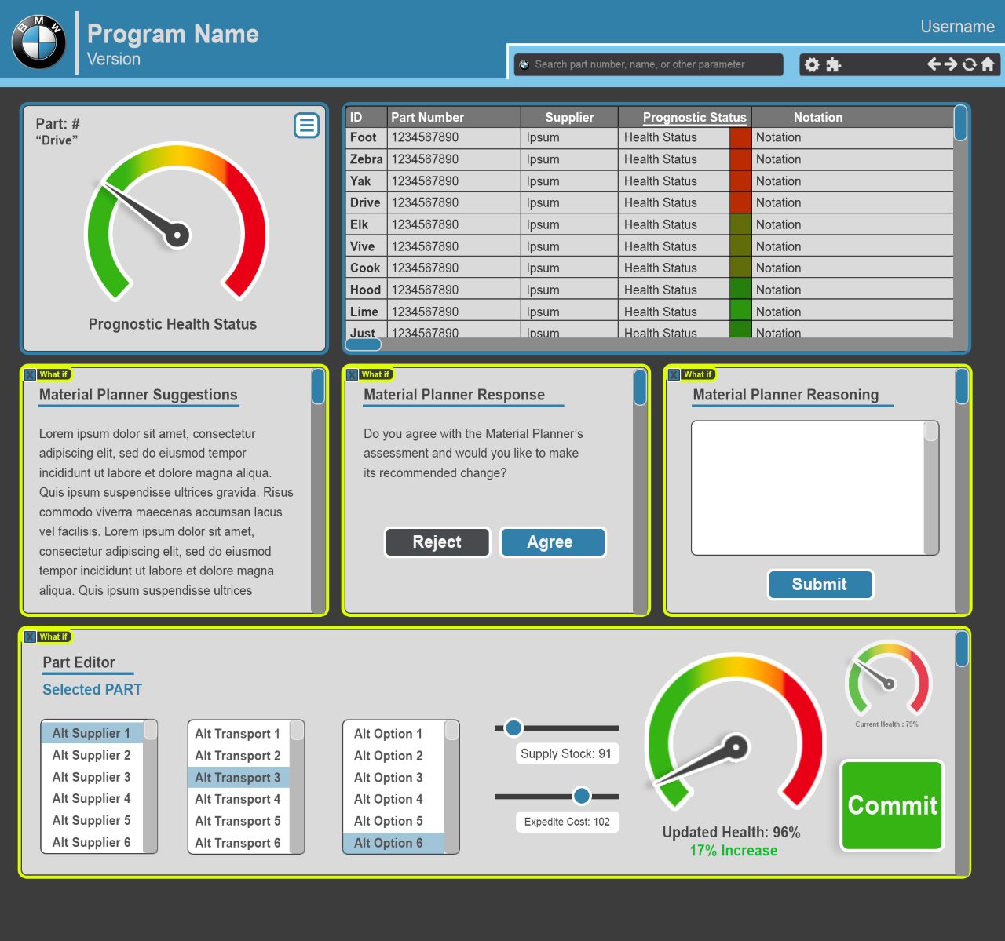
User Dashboards

Slide 2
Item #1: Part Health Status
Number that reflects how soon the item will need to be restocked (from 0 to 100)
Add a scale to the ranges based on BMW input, i.e. 0-10 is good, 11-30 is moderate, 31-99 is poor)
Input will come from Parts Forecasting Model
Item #2: Part Lookup
Fields include:
Material ID
Part Description
Supplier (Name and/or Number)
Status – input from parts forecasting model
Item #3: Part Detailed Description
Fields include:
Material ID
Part Description
Supplier
Stock/Safety Stock
Days of Supply
Exceptions

Slide 3
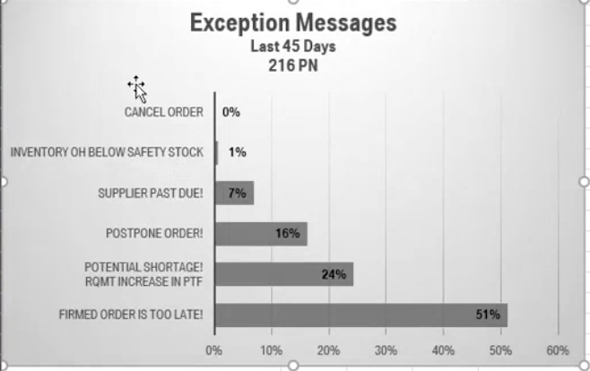
Item #4: Exception Manager
Bar Chart of total exceptions of all materials/parts in last 45 days
Bar Chart that shows which material/part contributing the most to total exceptions
Summary: Total exception count of a material and exception description
Input from BMW Data
Exception Data – need to identify where to access – ask Josh/Shawn

Slide 4
Item #5: Material Response Planner
Suggestion
Response
Reasoning
Input will come from Recommendation Engine
Output will be Planner Response and Reasoning

Slide 5
Parts Forecasting Model
Metrics for evaluating how we compute the health status
Evaluation metrics for the Markov model

